Slide 1
TinyFaces: Face Recognition on Arduino
Brian Boner, Jason Nguyen, Leon Vaughan, Dimitris Veliadis
Notes:
Leon

Slide 2



Motivation and Goals
Design and Create an AI model to detect specific faces
Possible use
Security System
Customer Identification
Attendance Tracking
Notes:
Leon

Slide 3
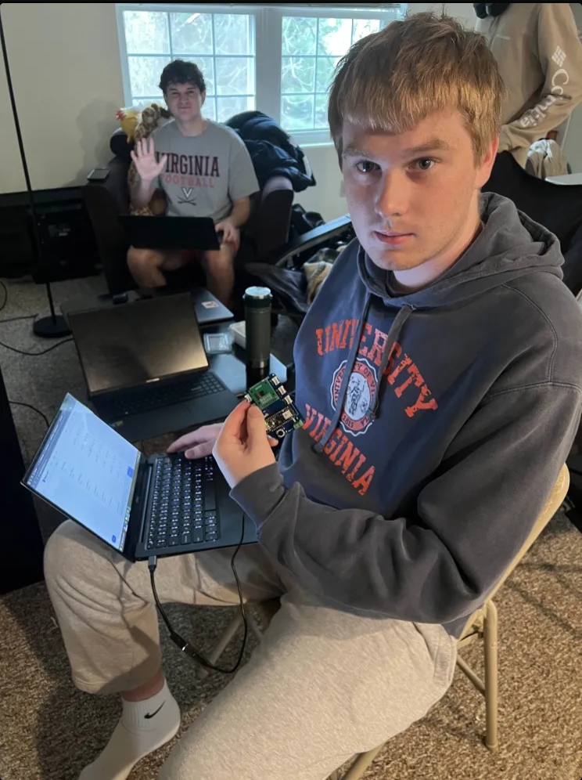
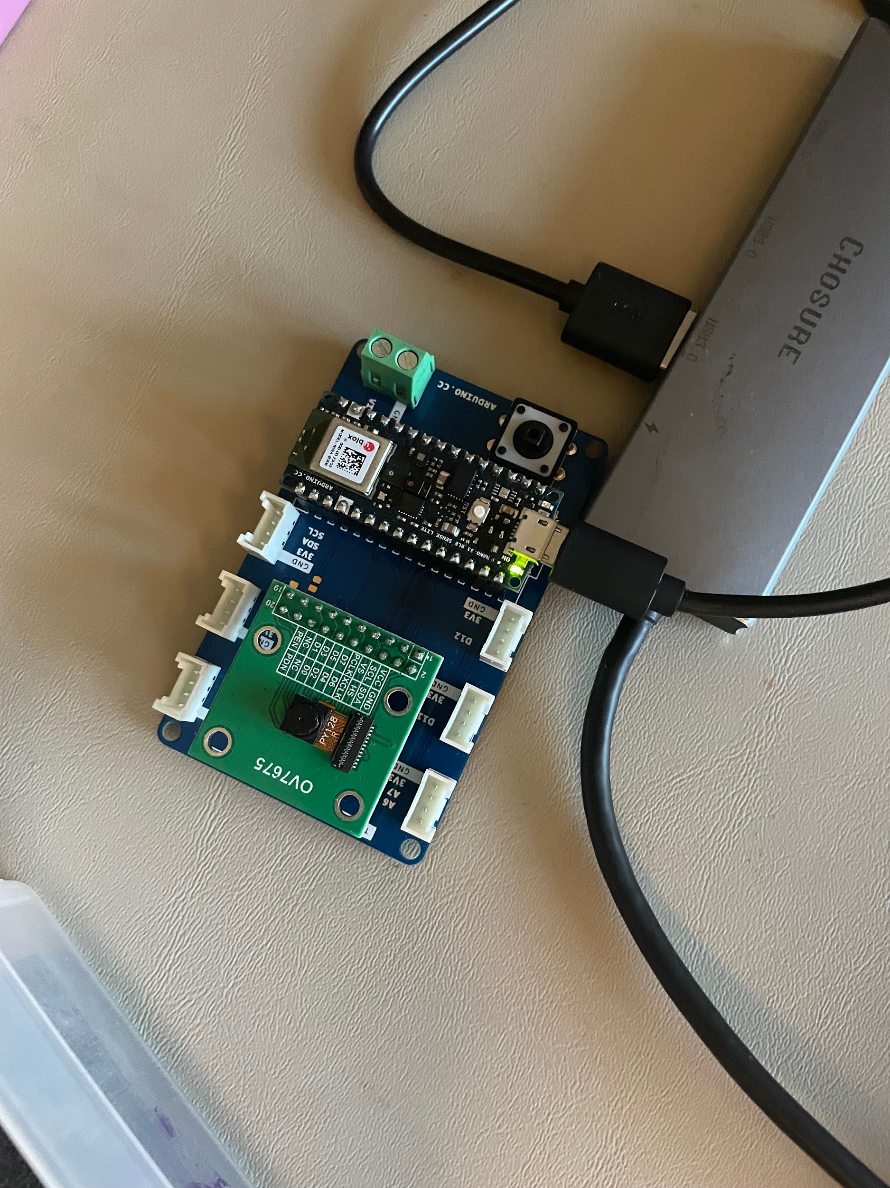
Project Steps
Step 1 - Hardware Setup
Arduino Nano Board
Arduino IDE
Step 2 - Software Setup
Python 3.12.7
Edge Impulse Model
Apache 2.0 Licensed Repository capturing images
Notes:
Brian

Slide 4






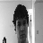

Project Steps
Up Profile
Step 3 - Model Training
Training dataset containing group member selfies and corresponding name labels, each with 5 profiles
Training dataset containing no faces labeled “background”
Left Profile
Jason
Right Profile
Center Profile
Leon
Brian
DJ
Down Profile
Notes:
Brian

Slide 5
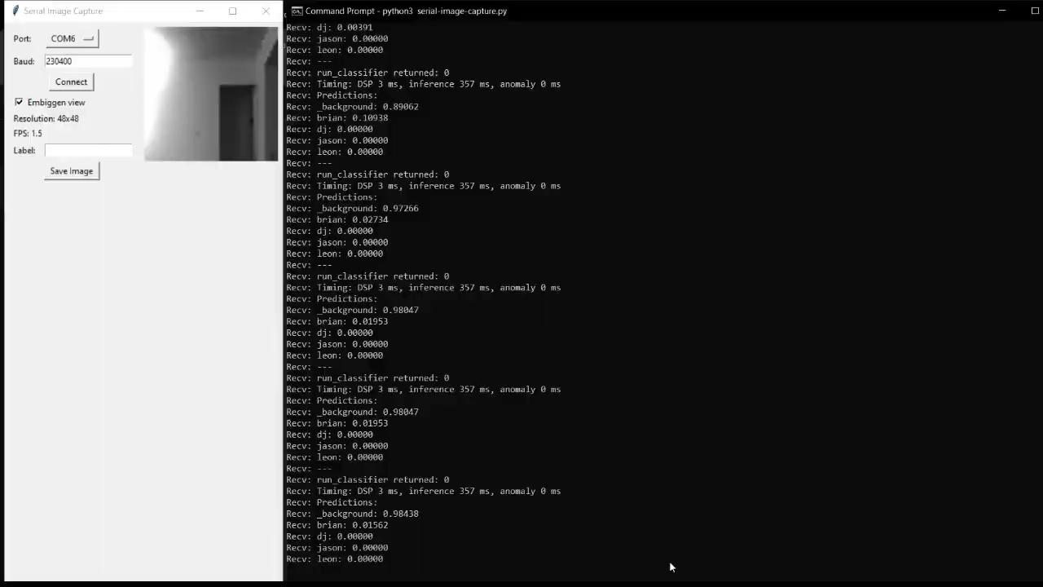
Demo Video

Slide 6

Results
Challenges in Training
Proper training data sets
Image Collection Time
Uploading Edge Impulse Time
Results Overview
75% Success Rate
Properly identified three team members
Properly identified background
Struggled on one member
Struggled with profiles
Potential Sources of Error
Room Lighting
Camera Angle/Position
Limited Training Dataset
Differing Appearances
Grayscale Limitation
Camera Quality
Notes:
Jason

Slide 7
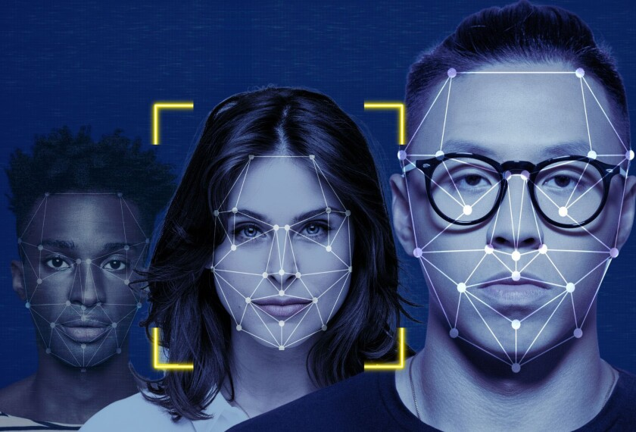
Lessons Learned and Conclusion
Conclusion Overview
High Success Rate
Promising Potential
Identification Issues
Arduino Lag
Takeaways / Future Improvements
Increase training dataset
Vary lighting in Training
Improve Hardware (resolution of camera)
Notes:
DJ

